Slide 1
College admission agent (rag based)
CAPSTONE PROJECT
Presented By:
1. Shreya S Suranagi – Maharani Lakshmi Ammanni College for Women Autonomous – Department of Computer Science

Slide 2
OUTLINE
Problem Statement
Proposed System/Solution
System Development Approach (Technology Used)
Algorithm & Deployment
Result
Conclusion
Future Scope
References

Slide 3
Problem Statement
The college admission offices and prospective students face a number of challenges every year during admission time. Students find it overwhelming to navigate through multiple web pages to find the admission policy, eligibility requirements. Staff face the challenge of answering repetitive inquiries at scale, in an accurate and timely manner. Additionally, misinformation or lack of clarity around courses, deadlines, and fees leads to confusion and missed opportunities.

Slide 4
Proposed Solution
An AI-powered admission agent using Retrieval-Augmented Generation (RAG) delivers real-time, accurate responses by sourcing information directly from institutional databases, documents and websites about courses, FAQ, fees, deadlines.etc. It streamlines student interactions, improves accessibility, and enhances the overall admissions experience.The solution will consist of the following components:
Data Collection:
Combine college data like admission policies, eligibility criteria, course details, application procedures, FAQs, and deadlines from official college databases, websites, and documents.
Continuously update the document to reflect real-time changes such as new regulations, fee updates, or deadline extensions.
Data Pre-processing:
Clean and structure both unorganized or heterogeneous documents (PDFs, web pages, etc.) and bring data into structured format like Q&A for consistency and retrieval.
AI Algorithm(RAG Architecture):
Implement a Retrieval-Augmented Generation (RAG) model with IBM Granite model that retrieves relevant passages from the indexed knowledge base and generates accurate, conversational responses to user queries.
Add tools such as Weather to find the next best in-person appointment date.
Deployment:
Develop a conversational interface for the AI Agent such as a Chatbot for students to ask queries in natural language.
Deploy the solution on IBM cloud platform which is scalable and reliable with low latency.
Evaluation:
Measure performance using metrics like response accuracy, retrieval relevance, and user satisfaction scores. Refine the system using feedback.
Result: The AI-powered admission agent provides instant, accurate, context-aware responses to student queries by leveraging RAG over institutional data, courses, fees, applications and deadlines, enhancing clarity and engagement in the application process.

Slide 5
System Approach
The "System Approach" section outlines the overall strategy and methodology for developing and implementing the rental bike prediction system. Here's a suggested structure for this section:
System requirements
IBM Cloud
IBM Watsonx studio - for model development and deployment
IBM Cloud Object Storage - for storing institutional documents, policies, real-time data sources and the project.
Watsonx Runtime - for secure and scalable AI model deployment, management and execution.
IBM watsonx.ai – for building, tuning, and managing large language models
IBM Agentic Lab(beta) – for building and deploying the AI agent
Library required to build the model
Watsonx Runtime – for hosting and serving Granite and open-source foundation models at scale.
IBM Granite model – for natural language processing and summarization.

Slide 6
Algorithm & Deployment
Algorithm Selection:
The system uses IBM's Granite foundation model, integrated within a Retrieval-Augmented Generation (RAG) framework. Granite was selected for its strong natural language understanding capabilities, enterprise-grade trust features, and seamless integration within IBM’s watsonx environment. Its ability to generate contextually accurate responses makes it ideal for college admission use cases
Data Input:
The model takes two main inputs: natural language questions from students and embedded knowledge chunks retrieved from stored college documents such as policies, FAQs, application guides, and course catalogs in IBM Cloud Object Storage.
Training Process:
While IBM Granite is a pre-trained model, It can be customized or tuned within watsonx.ai using domain-specific data like college data. Embedding generation and retrieval configurations are handled using IBM Agentic Lab, and the system is optimized for accurate document matching and minimal hallucination.
Prediction/Retrieval Process:
When a query is submitted, the RAG pipeline retrieves the most relevant documents based on semantic similarity. These documents, along with the original query, are passed to the deployed IBM Granite model via Watsonx Runtime, which generates a well-informed, real-time answer. This ensures students receive responses grounded in institutional truth and updated policies.

Slide 7
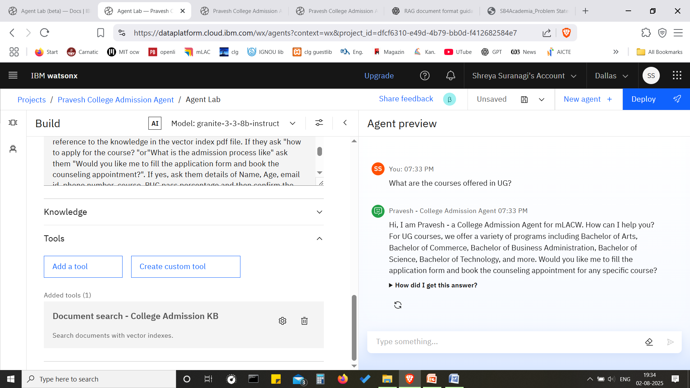
Result-slide 1

Slide 8
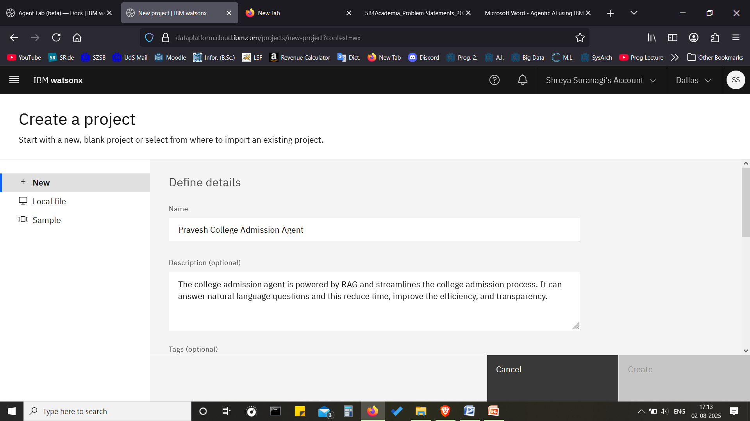
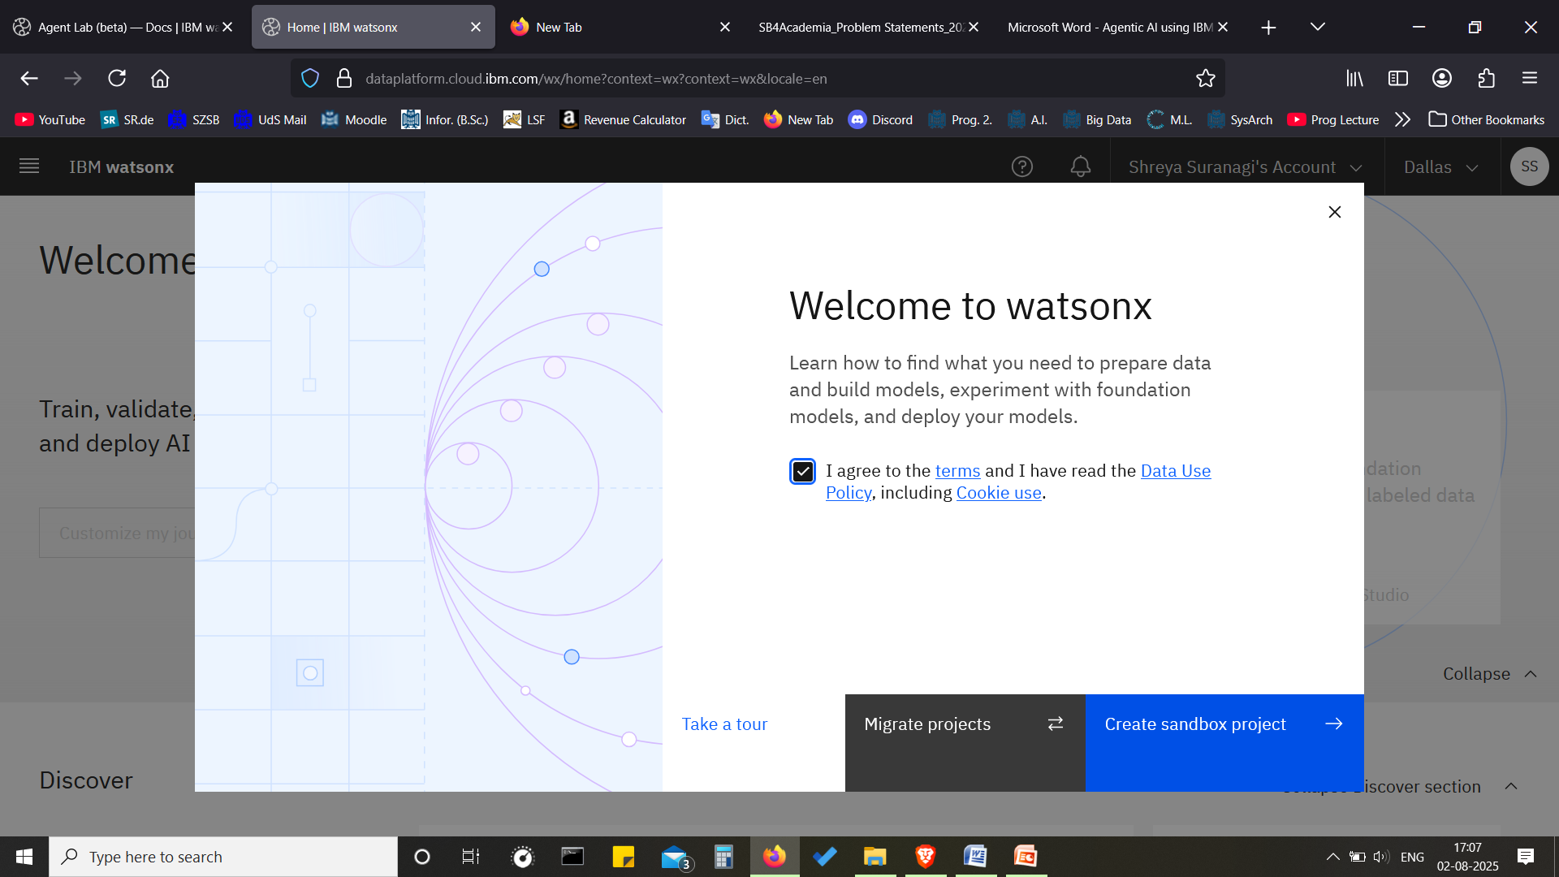
Result-slide 2
HOW TO SET UP(Slide 2-Slide 6)
Login to IBM Cloud
Click on watsonx from panel.
Click on Agentic AI Lab(beta).
Select create a sandbox Project.
Click on Create a project instead.
Enter name of project and description

Slide 9
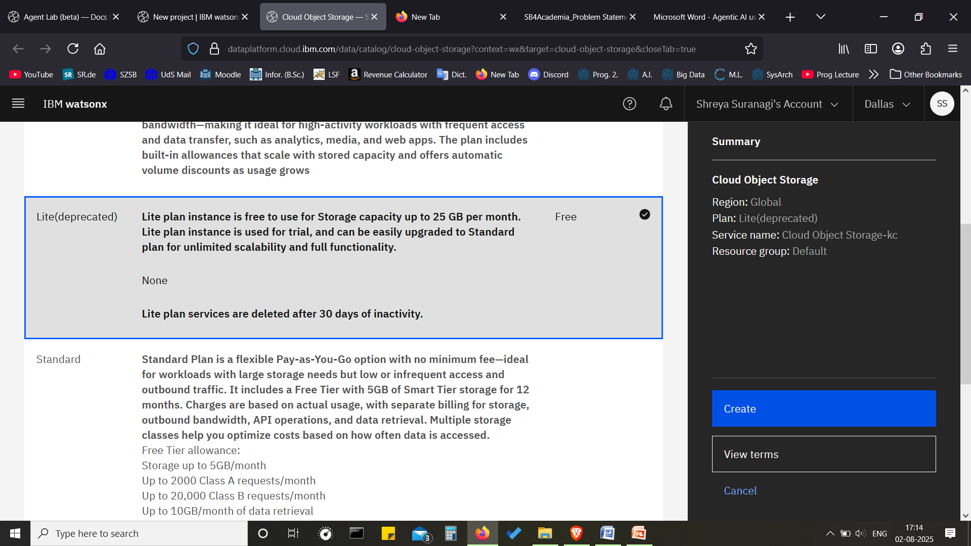
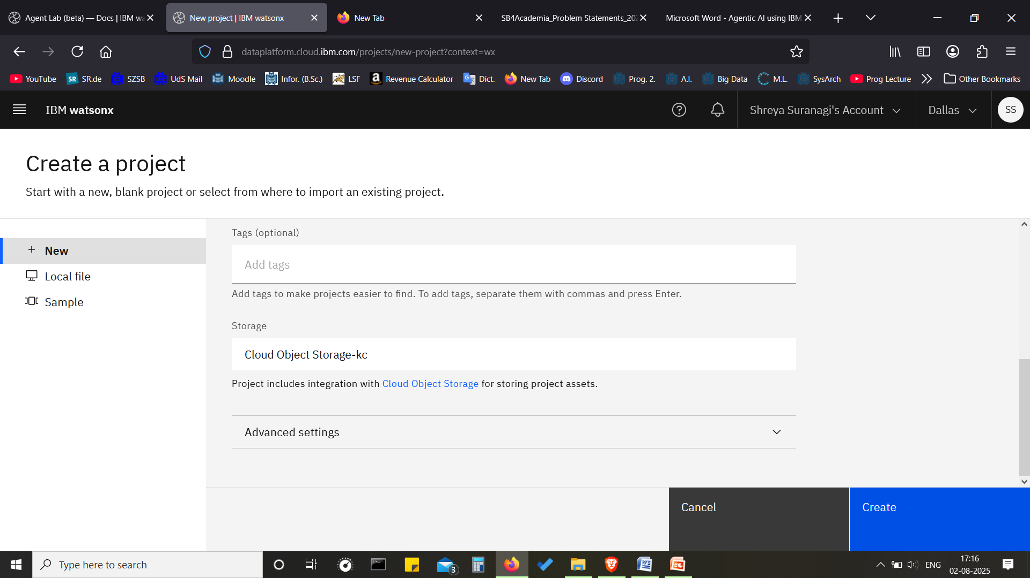
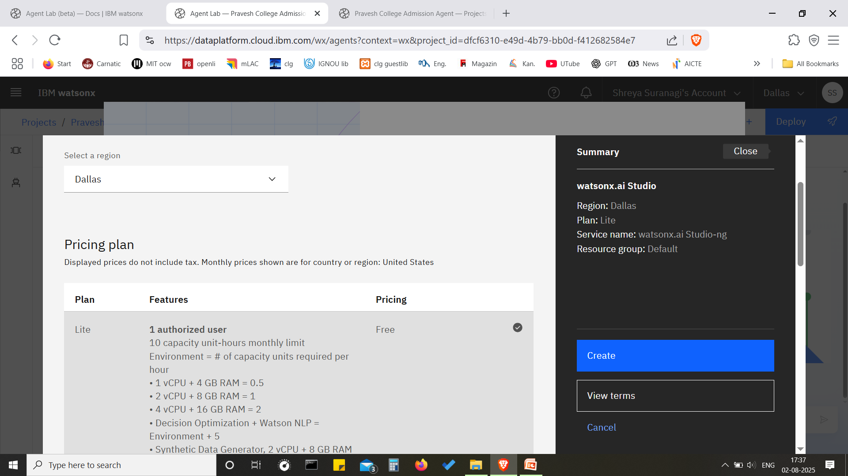
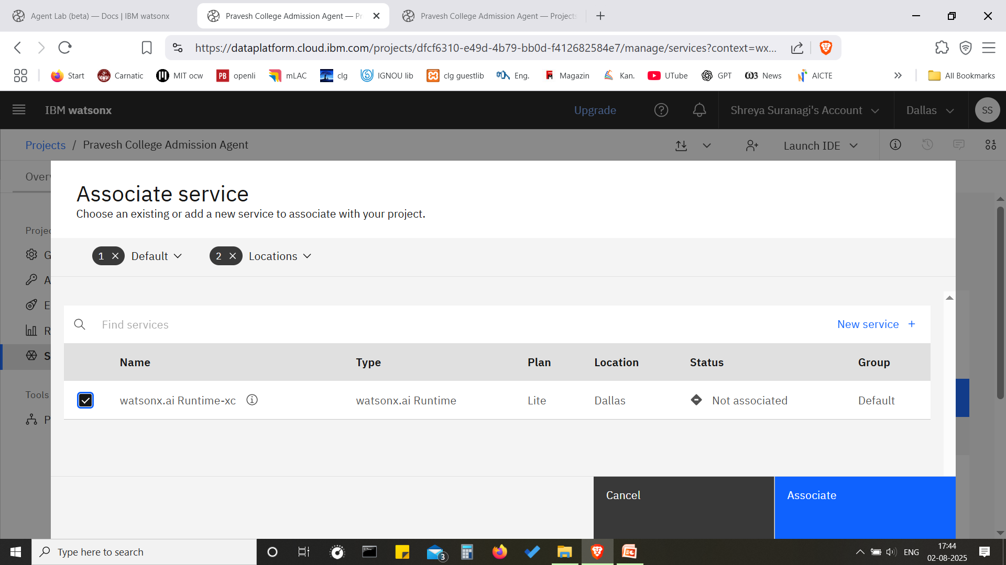
Result-SLIDE 3
Add the required cloud Storage
This will create the storage space or memory required for the documents for RAG
Click on Build an Agent and Create.
Associate watsonx.ai Runtime service
It will help run models and serve requests
Click on Associate

Slide 10
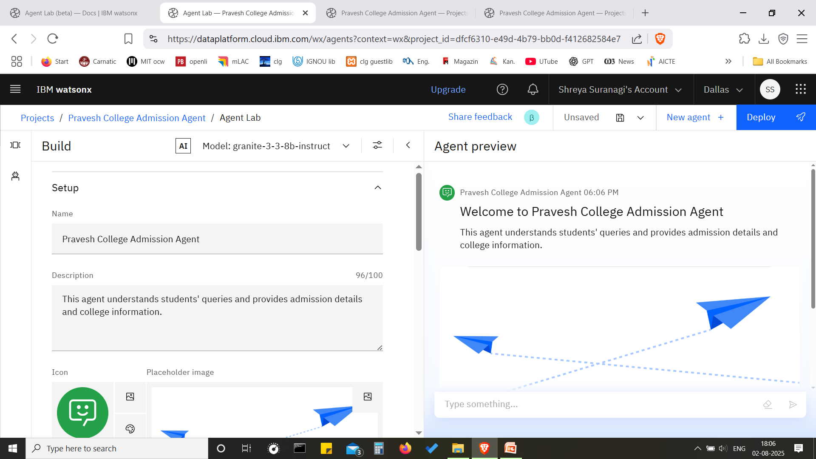
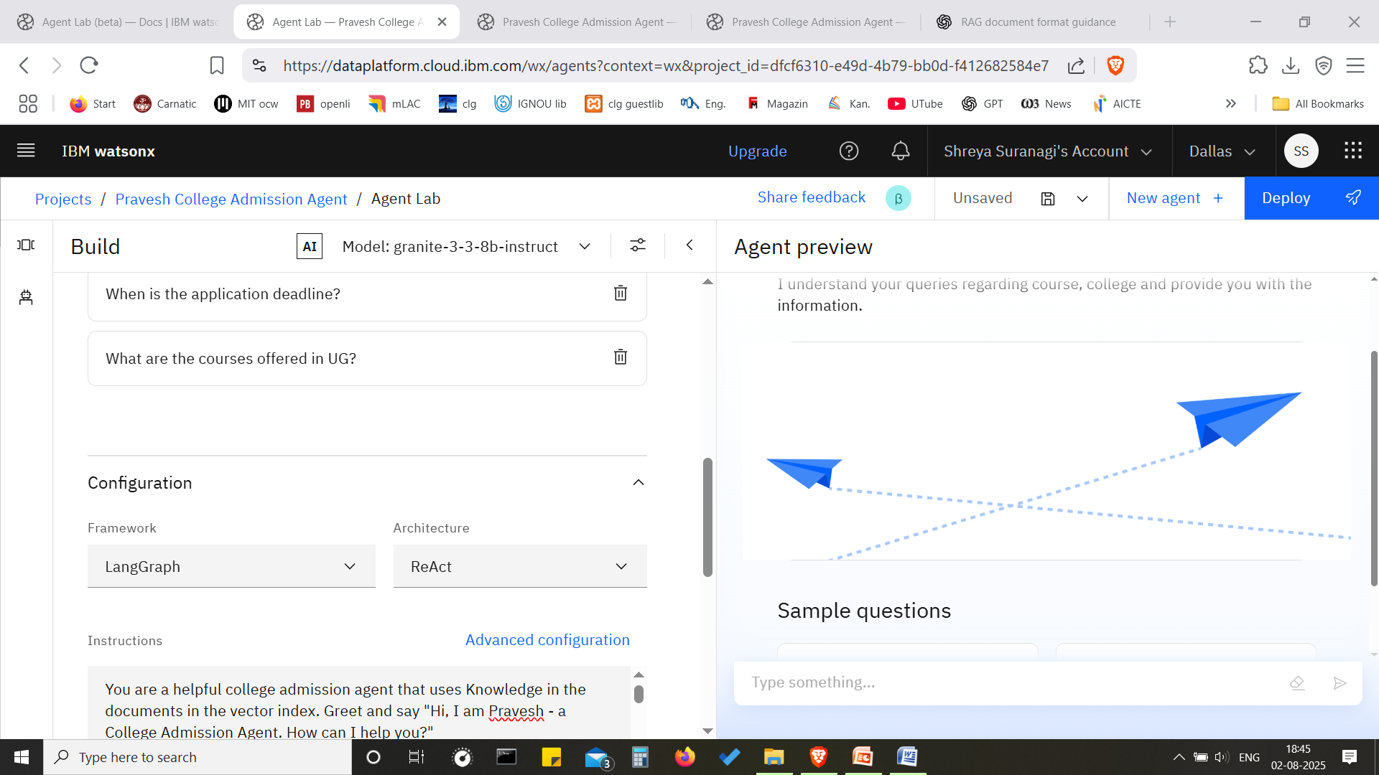
Result-slide 4
Provide the agent name and description
Select Model as IBM Granite Model or any of your choice
Framework is LangGraph and Architecture is ReAct
Provide Instructions for the agent.

Slide 11
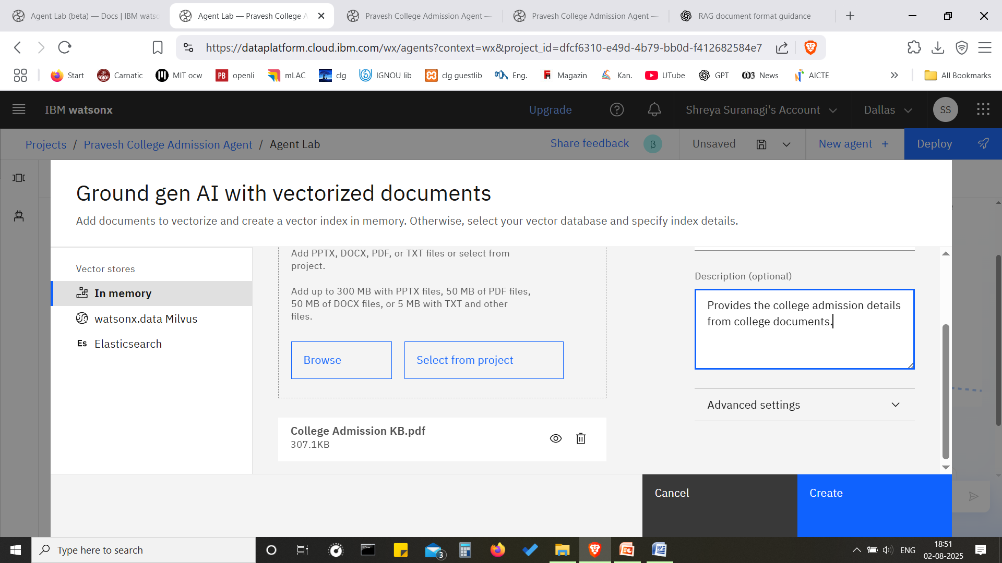
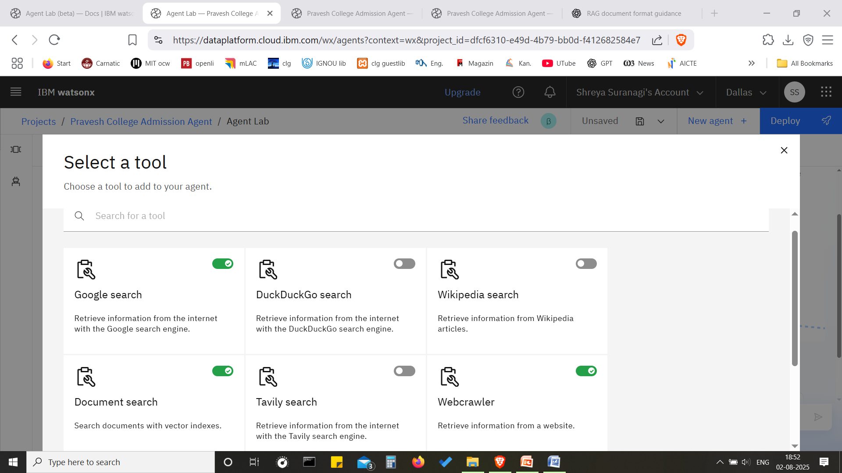
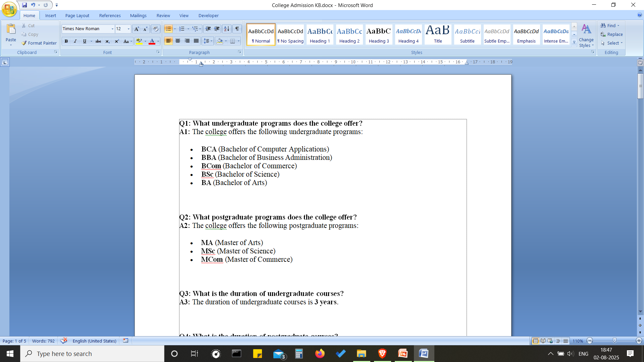
Result-slide 5
Prepare the document will admission information.
Upload the document as pdf to be vectorized for retrieval
In the Tools section, select Document search and other relevant tools

Slide 12
Result-slide 6
Query:
What are the courses offered in UG?
Data retrieved successfully from the college document.

Slide 13
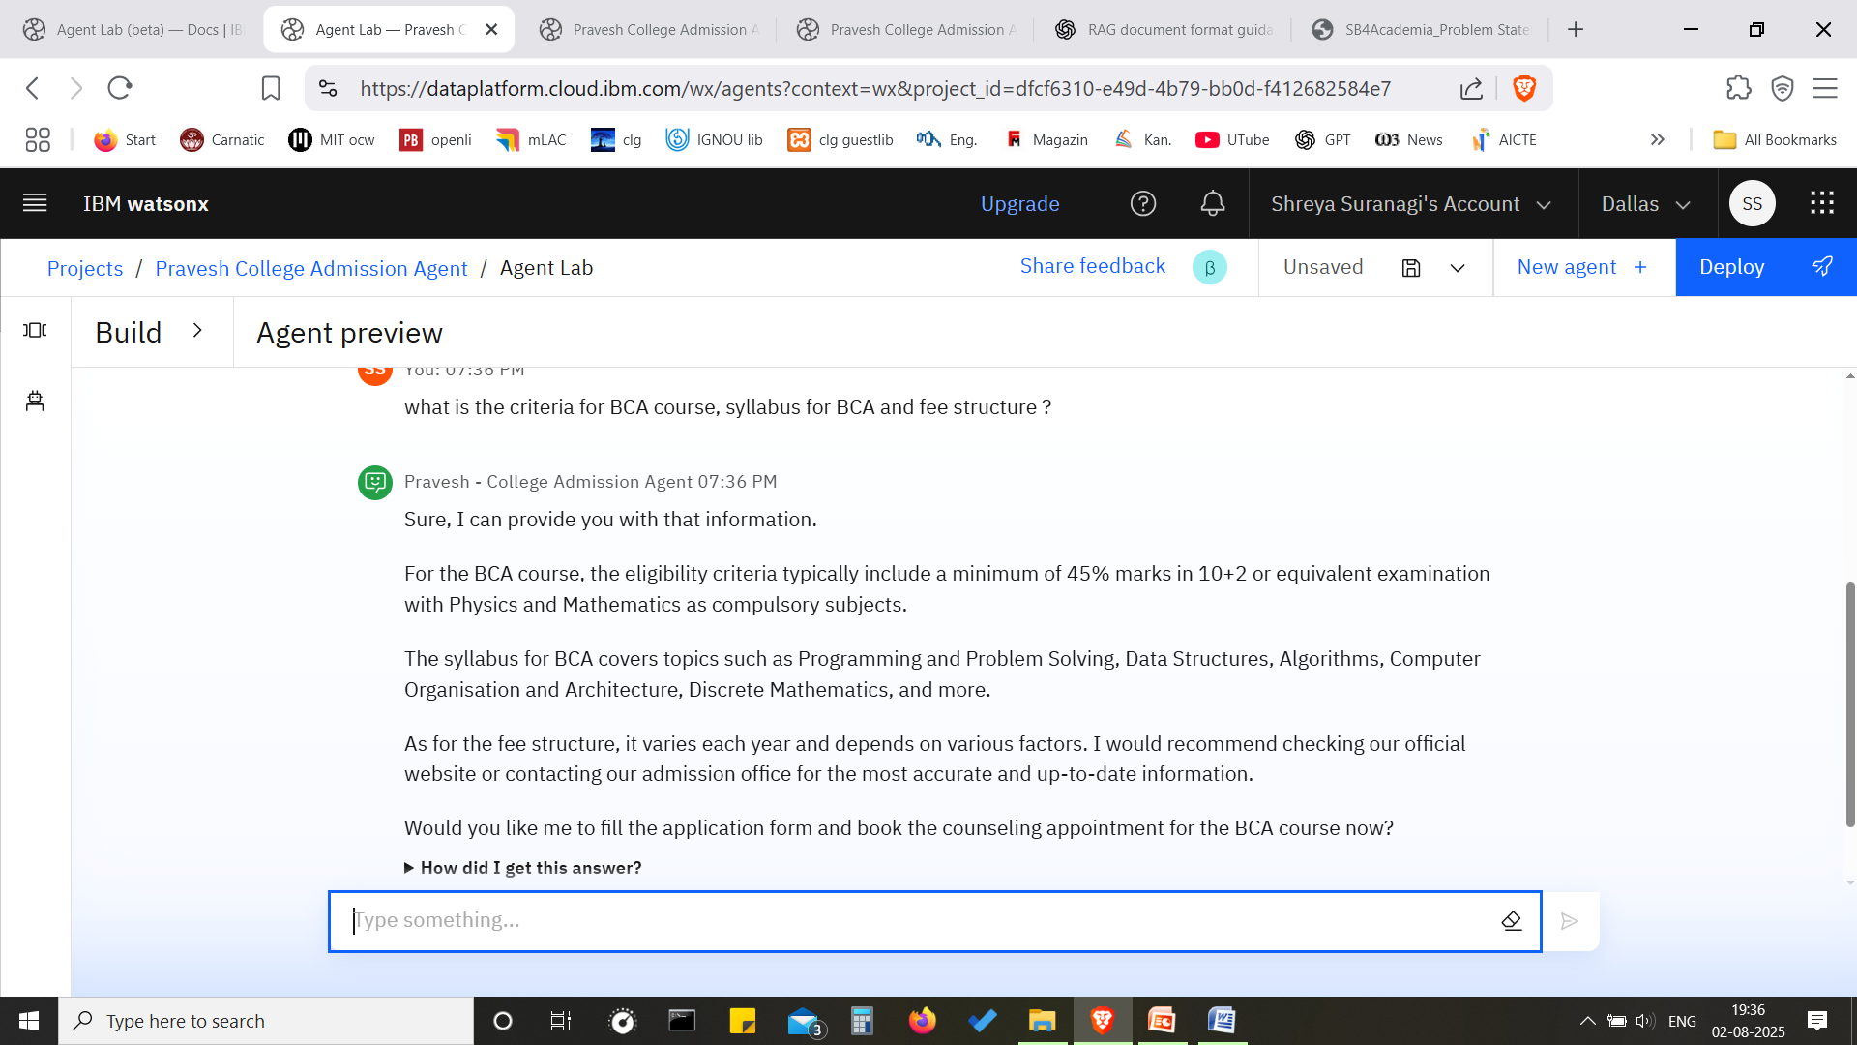
Result-slide 7
Query:
What is the criteria for BCA course, syllabus and fee structure?
The agent successfully retrieved the data from the uploaded link of the pdf of syllabus document. However, it failed to get the fee structure.

Slide 14
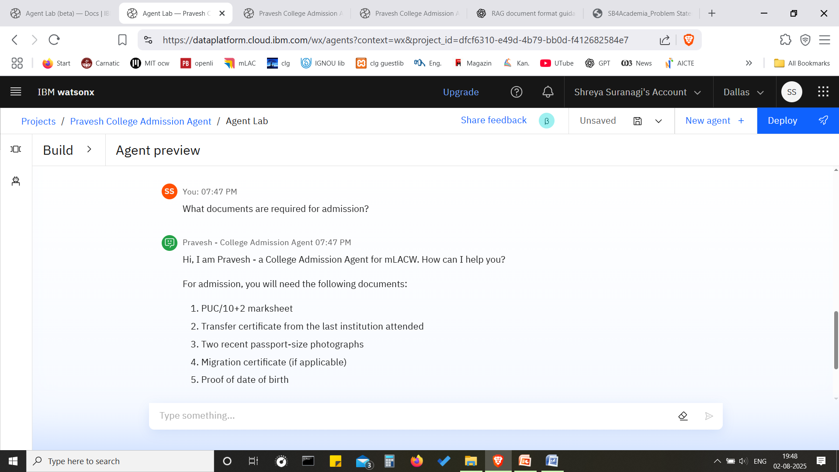
Result-slide 8
Query:
What documents are required for admission?
The agent successfully retrieved the accurate data. It distinguished between admission and application.

Slide 15

Result-slide 9
The agent received the Student details, booked an appointment for a college course counseling session and sent a confirmation email.

Slide 16
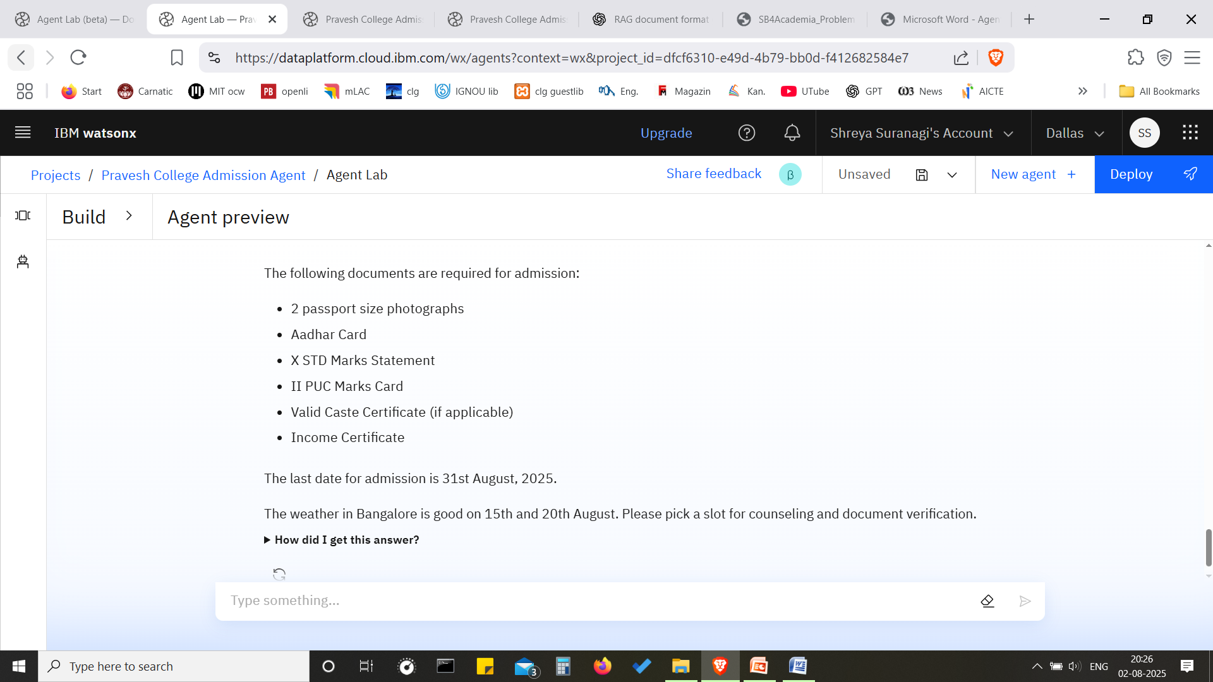
Result-slide 10
The agent asked for the best date for an appointment slot based on the weather.

Slide 17
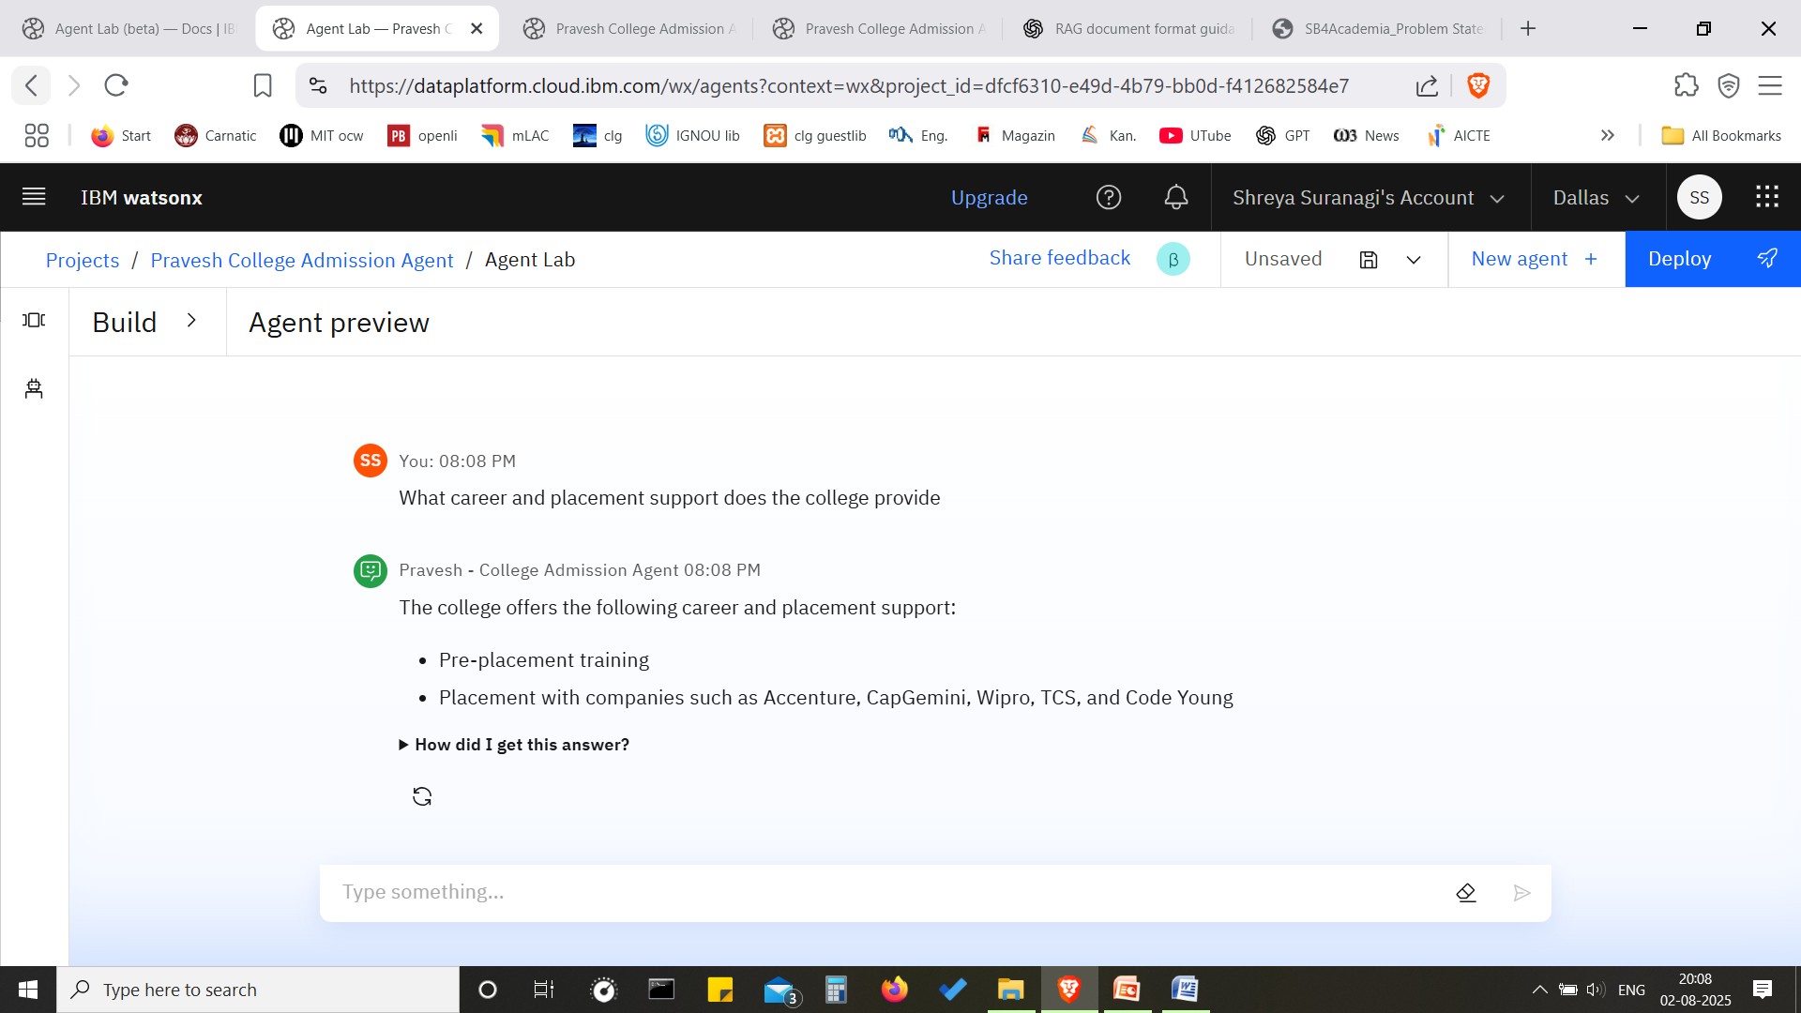
Result-slide 11

Slide 18

Result-slide 12

Slide 19
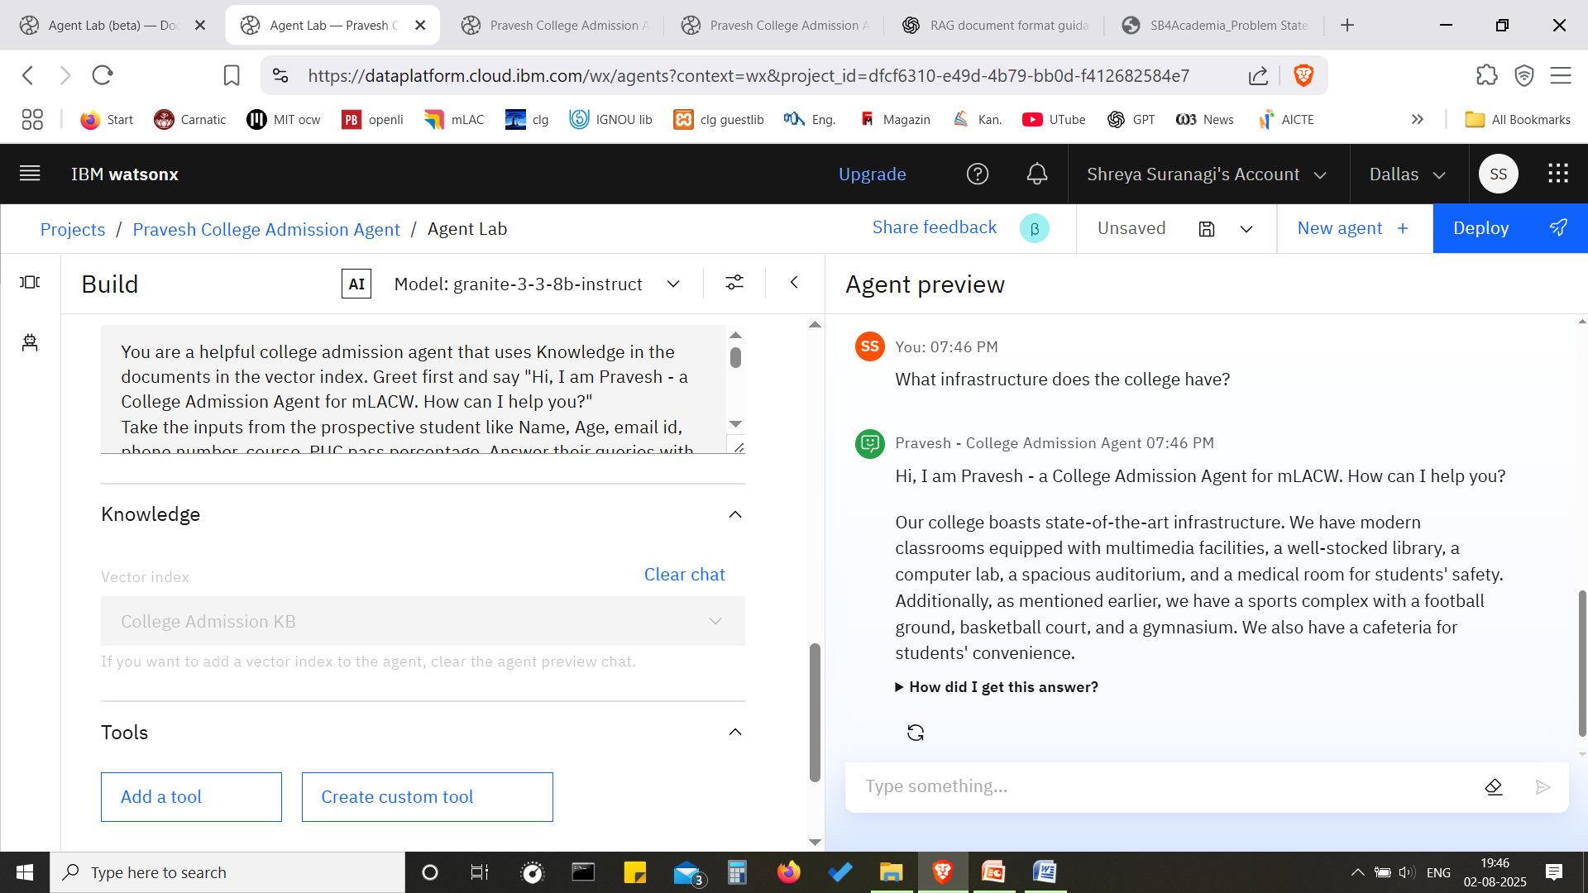
Result-slide 13
Note: If Google search is enabled, provide the college website, otherwise the Agent may hallucinate

Slide 20
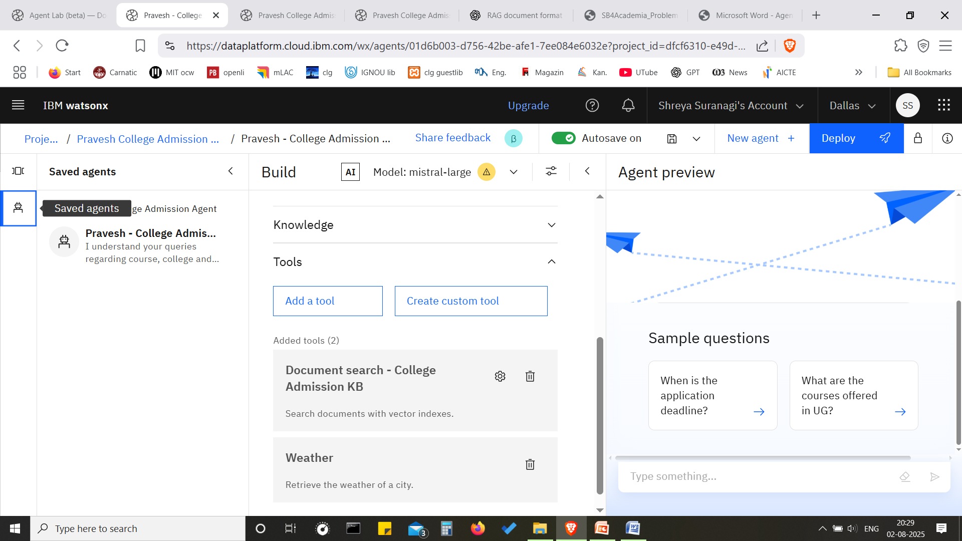
Result-slide 14
Saved the Agent

Slide 21
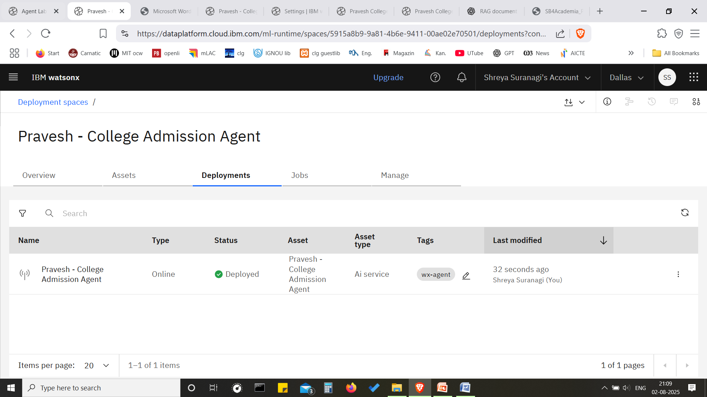
Result-slide 15
Deployed
Github Link- https://github.com/shreyasuranagi?tab=repositories

Slide 22
Conclusion
The AI-powered college admission agent built with IBM Granite and Retrieval-Augmented Generation (RAG) has shown strong potential in simplifying how students interact with complex admissions information. By pulling responses directly from official college documents, the agent delivers accurate, trustworthy answers—cutting down on confusion and reducing the need for manual support.
While the system excels at providing fact-based information, it still faces challenges when questions require deeper reasoning or aren’t clearly addressed in the documents.

Slide 23
Future scope
Looking ahead, there are several ways to make the agent even more helpful and intuitive. Enhancing how it understands and retrieves information—not just by matching keywords, but by truly grasping the intent behind a question—will improve its usefulness.
Adding a reasoning layer could help it handle more complex queries that require logic or multiple pieces of information.
There's also a big opportunity in making it multilingual, personalizing its responses based on the type of student, and extending it to mobile and voice platforms for easier access.

Slide 24
References
IBM watsonx.ai Documentation – https://www.ibm.com/docs/en/watsonx
IBM Granite Foundation Models – https://www.ibm.com/watsonx/granite
IBM Cloud Object Storage – https://www.ibm.com/cloud/object-storage
IBM Agentic Lab(beta)– https://www.ibm.com/docs/en/watsonx/saas?topic=agents-agent-lab-beta
Retrieval-Augmented Generation (RAG), Facebook AI Research, 2020
OpenAI Research on RAG and Hallucination – https://openai.com/research
https://skillsbuild.org/college-students/course-catalog/introduction-to-retrieval-augmented-generation

Slide 25
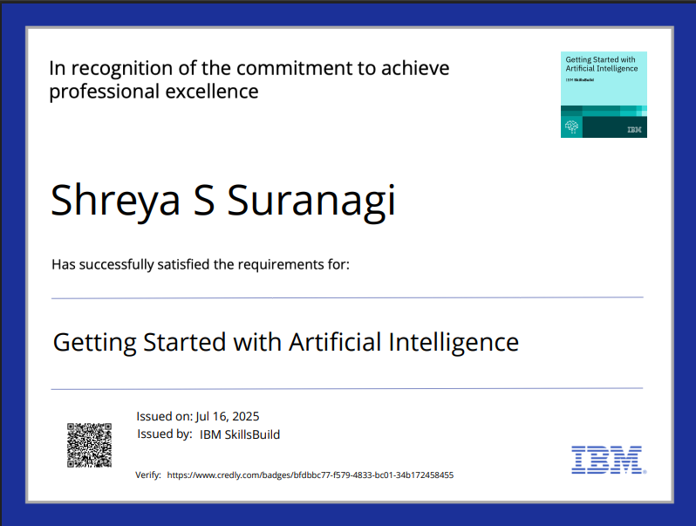
IBM Certifications

Slide 26
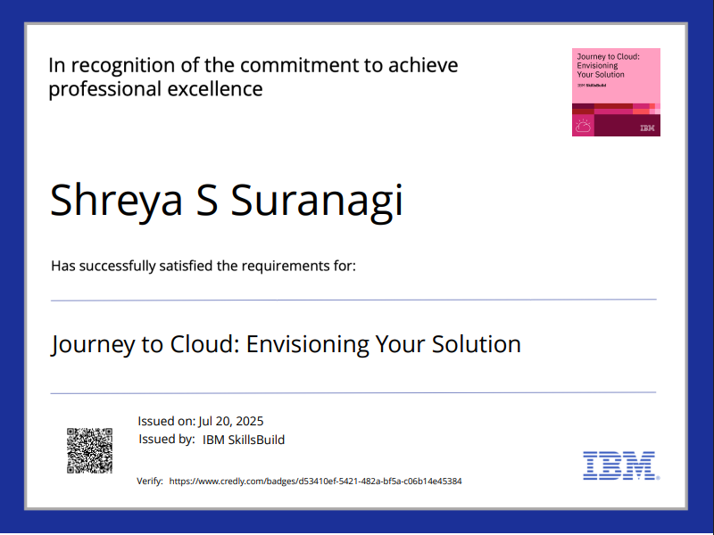
IBM Certifications

Slide 27
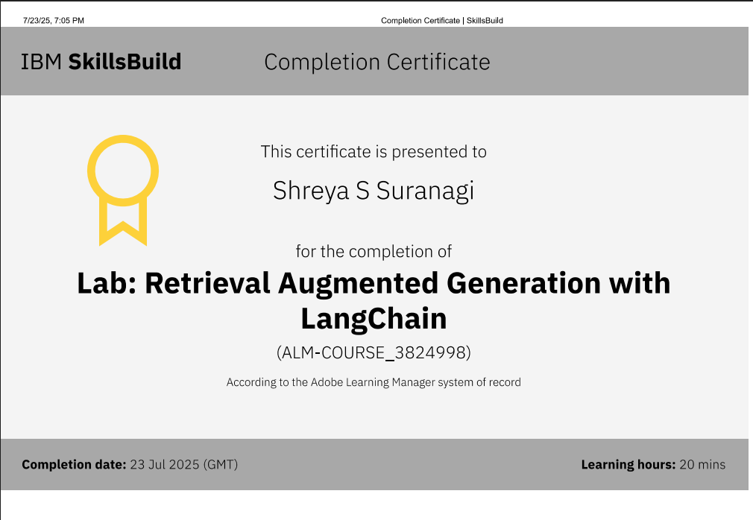
IBM Certifications

Slide 28
THANK YOU

